Slide 1
CLIMATE RESPONSE
SPRINT 2026

Slide 2

CLIMATE RESPONSE
SPRINT 2026
Accelerating solutions for a net-zero future
A two-stage pathway from global solution discovery to UAE deployment, validation and global showcase.
MOCCAE | SEE Institute | Bedayat
Notes:
[Sources]
- Climate Response Sprint 2026 programme document; MOCCAE Entrepreneurship & Innovation Ecosystem, slides 30-35.
- Visual on this slide was generated with Microsoft Copilot.
[/Sources]

Slide 3
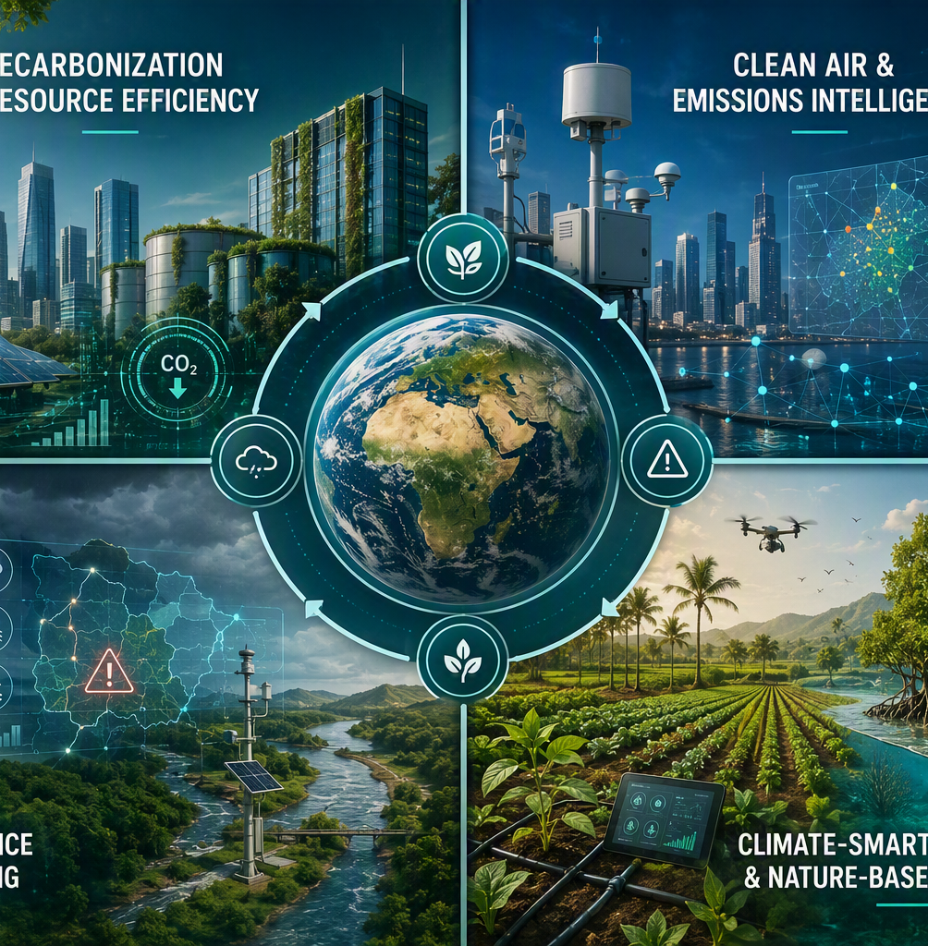
Strategic Goal & Programme Objectives
Positioning MOCCAE as an active orchestrator of challenge-driven climate innovation.
STRATEGIC GOAL
Convert priority climate and environmental challenges into measurable, UAE-ready solutions with clear pathways to pilot, adoption and scale.
Identify UAE-ready solutions
Surface validated innovations aligned with climate, clean air, resilience and green-development priorities.
01
02
Build a national innovation pipeline
Attract global startups and strengthen a sustained pipeline aligned with MOCCAE priorities.
03
Access validated prototypes
Advance near-deployment solutions toward piloting, evidence generation and policy-linked integration.
04
Strengthen MOCCAE positioning
Reinforce MOCCAE as a national innovation enabler that mobilizes partners, investors and talent.
Notes:
[Sources]
- MOCCAE Entrepreneurship & Innovation Ecosystem, slides 31-32; Climate Response Sprint 2026 programme document.
- Visual on this slide was generated with Microsoft Copilot.
[/Sources]

Slide 4
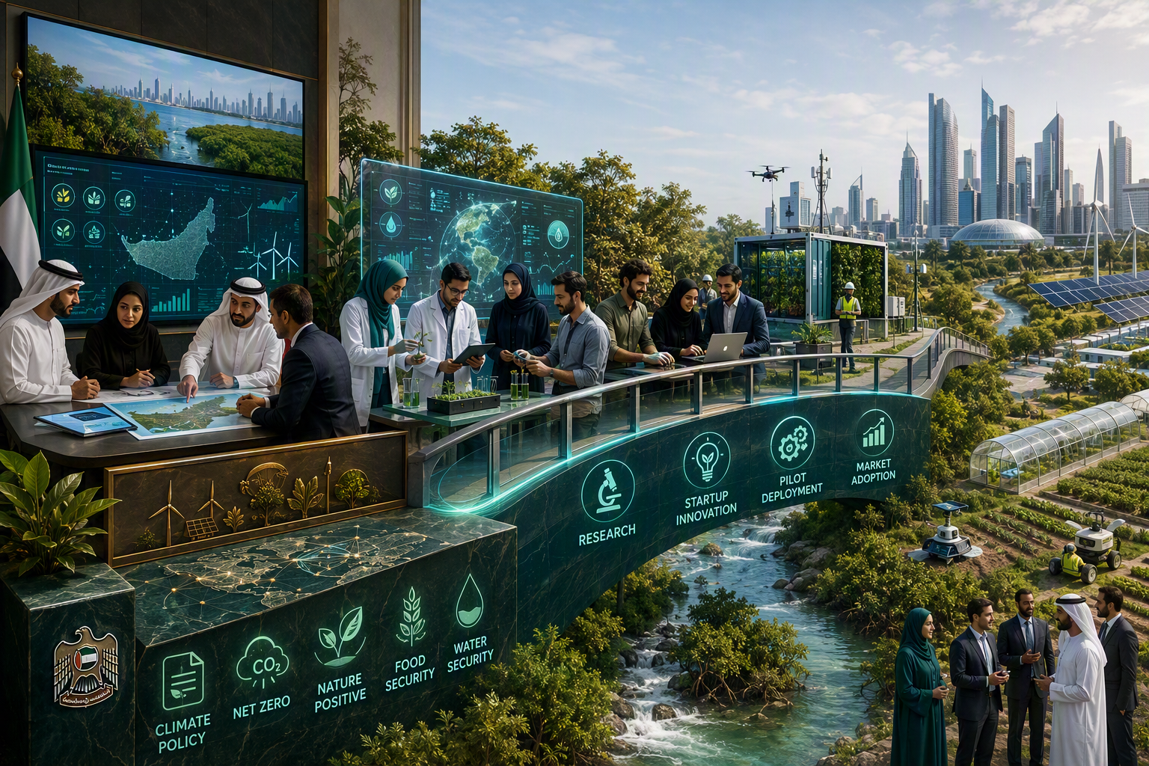
Programme Content: Four Priority Innovation Themes
AI, advanced analytics, digital twins, smart sensing and environmental intelligence act as cross-cutting enablers.
Decarbonization, Resource Efficiency & Carbon Management
1
Reduce emissions at source, improve energy and resource efficiency, and enable better carbon measurement and management.
Clean Air, Emissions Intelligence & Public Health Protection
2
Strengthen monitoring, forecasting, exposure intelligence and targeted emissions-reduction action.
Climate Resilience, Environmental Risk & Early Warning
3
Improve predictive capability, environmental-risk preparedness and proactive operational response.
Climate-Smart Agriculture, Land & Nature-Based Solutions
4
Advance resilient agriculture, efficient resource use, land restoration and nature-positive climate action.
Notes:
[Sources]
- Climate Response Sprint 2026 programme document, Priority Innovation Themes and Cross-Cutting Technology Enablers.
- Visual on this slide was generated with Microsoft Copilot.
[/Sources]

Slide 5
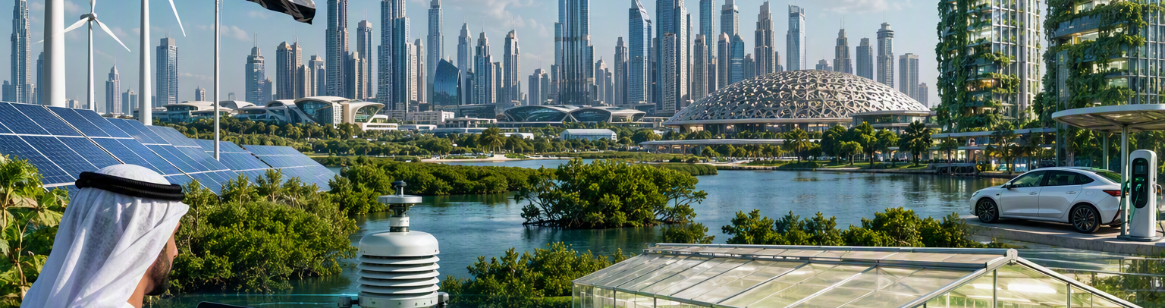
Program Journey
A competitive funnel from open call to deployment validation and international visibility.
21-30 SEP
1 OCT
5-14 OCT
15 OCT
MID OCT-NOV
DEC-JAN
Launch & applications
Top 10 selection
Sprint bootcamp
Top 10 pitch
Advanced accelerator
Final 3 showcase
National and global open call
Multidisciplinary evaluation
10-day intensive refinement
Proposed Forbes event
Top 3-5 validation track
GITEX & ADSW*
*Showcase participation is subject to event timing, organizer approval, space availability and project readiness.
Notes:
[Sources]
- Revised journey provided by the user and incorporated in Climate Response Sprint 2026 revised programme journey document.
- Visual on this slide was generated with Microsoft Copilot.
[/Sources]

Slide 6
Two-Stage Accelerator Structure
Phase 1 builds a compelling, deployment-oriented proposition. Phase 2 turns the strongest projects into validated implementation cases.
PHASE 1
PHASE 2
Sprint Accelerator Bootcamp
Advanced Deployment & Validation
Top 10 | 10 days | 5-14 October
Top 3-5 | Approx. 6 weeks | Mid-Oct to late Nov
Challenge alignment & user validation
Pilot design, baseline and validation methodology
Technical solution and data-readiness review
Technical integration, data and cybersecurity readiness
Environmental impact framework and KPIs
Policy, regulatory and approvals pathway
Business model, market fit and UAE deployment pathway
Impact measurement and verification plan
Policy, regulatory and risk clinic
Commercial, procurement and investment readiness
Pitch development, mock judging and final refinement
Scaling roadmap and committed implementation partnerships
OUTPUT
Refined solution, impact KPIs, pilot concept, partnership map and pitch deck
OUTPUT
Validated deployment case, partner commitments, investment brief and scale-up roadmap
Notes:
[Sources]
- Climate Response Sprint 2026 revised programme journey document, Phase 1 and Phase 2 accelerator sections.
- Visual on this slide was generated with Microsoft Copilot.
[/Sources]

Slide 7
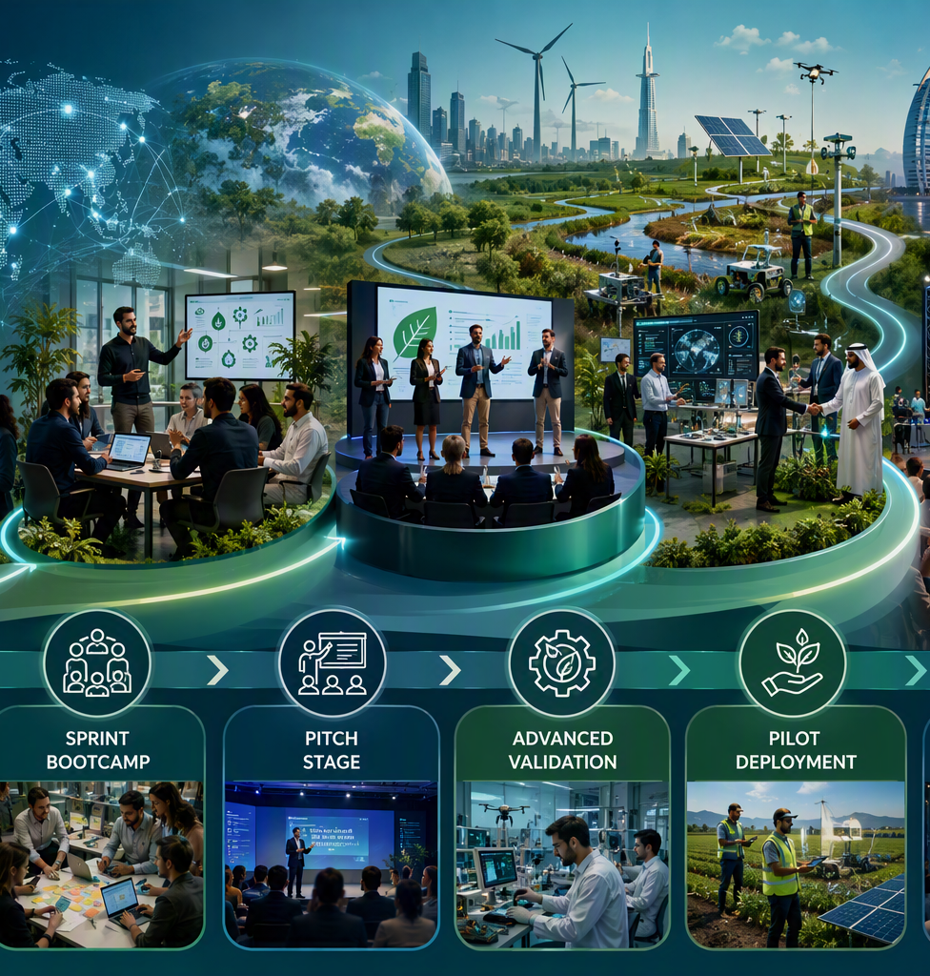
Partnership & Governance Model
Core partners lead the programme, while specialist partners are mobilized according to each finalist’s deployment needs.
MOCCAE
Strategic direction, challenge ownership, policy and technical mentorship, evaluation, stakeholder access and government/industry connections.
SEE Institute
Sustainability expertise, Phase 1 delivery, impact and deployment mentoring, Phase 2 validation support and specialist ecosystem access.
Bedayat
Programme operations, application management, startup and business acceleration, mentor coordination, investor engagement and communications.
ADDITIONAL PHASE 2 PARTNERS
Government & local authorities
Industry & infrastructure operators
Technology & data partners
Universities & research institutions
Investors & climate-finance partners
Legal, standards & assurance specialists
Notes:
[Sources]
- Climate Response Sprint 2026 revised programme journey document, Programme Governance and Roles and Proposed Phase 2 Partner Model; MOCCAE Entrepreneurship & Innovation Ecosystem, slides 29 and 31-34.
- Visual on this slide was generated with Microsoft Copilot.
[/Sources]

Slide 8

Thank you!
www.moccae.gov.ae
@MOCCAEUAE

